Slide 1
Leslie Me
Psychedelic Medicines and Our Patients: Promoting Safety, Guiding Consciously and Optimizing in an Easy Access World
International Congress for Integrative Medicine & Health
March 6, 2025
Seattle, Washington
Leslie Mendoza Temple, MD
Erika Steinbrenner, MD
Mikhail Kogan, MD
Thais Salles Araujo, MD
Justin Laube, MD

Slide 2
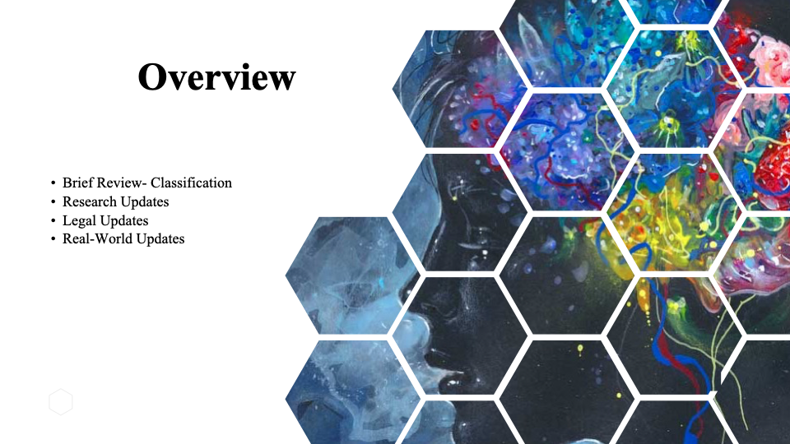
IRCIMH Presentation in Cleveland, 2024
Nesting psychedelics within Integrative Medicine
Historical and cultural context of psychedelic substances
Broad overview of psychedelics from conventional medicine viewpoint
Ethics, Safety

Slide 3
From last year in Cleveland, IRCIMH 2024
Mescaline from Peyote, San Pedro and Peruvian Torch cacti
DMT and Ayahuasca
5-Methoxy-DMT or “The Toad”
Ibogaine
LSD
MDMA
Kratom*
Psilocybin
Ketamine
*not a psychedelic substance

Slide 4
As your questions and comments arise, enter them in the WHOVA app.
You can upvote questions or ask your own.

Slide 6
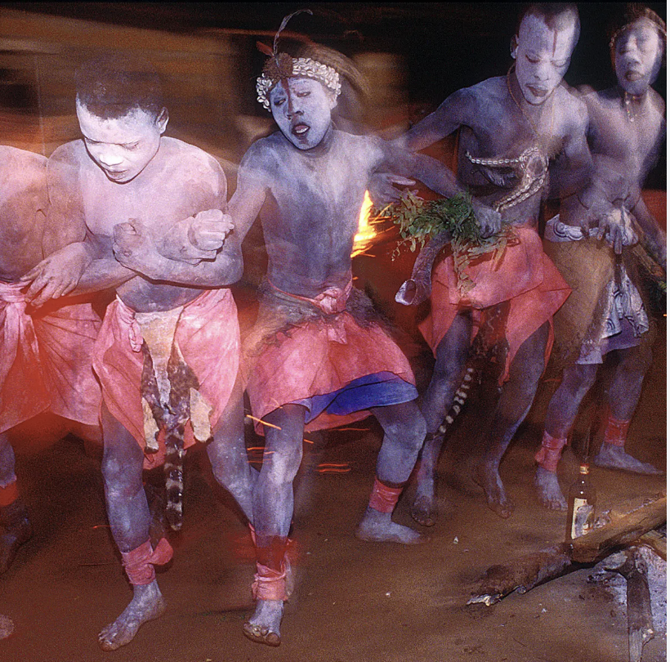
Cultural Roots & Westernization
It is our job to acknowledge and respect the wisdom of the cultures that have shared their tools of healing and medicine with the world.
“There is a lack of diversity within the field of psychedelic researchers, with Indigenous people and people of color underrepresented both as researchers, therapists, and participants in studies.”
George JR, Michaels TI, Sevelius J, Williams MT. The psychedelic renaissance and the limitations of a White-dominant medical framework: a call for indigenous and ethnic minority inclusion. J Psychedelic Stud. 2020;4:4–15.
Michaels TI, Purdon J, Collins A, Williams MT. Inclusion of people of color in psychedelic-assisted psychotherapy: a review of the literature. BMC Psychiatry. 2018;18:1–9.
Notes:
Leslie- My role will be to help set the stage, starting with a gong/bell, a fewcentering breaths and a call to prepare the mind to receive new information. I will acknowledge the peoples and cultures that originated this form of healing, and then go through the agenda. The 2 or 3 patient cases will be highlighted as food for thought throughout the presentation. I will state that we are going through the psychedelic substances which the general U.S.practitioner might be most likely asked about during patient visits or outside the clinic: namely Ketamine, psilocybin, MDMA, and Ayahuasca. I will share the link for our slides from last year for reference. I will also make a general comment about how regulation is rapidly changing regarding psilocybin, and that the state of MDMA is in flux with last year's FDA hearings, and that Ketamine is the only legal psychedelic substance in the U.S.
In the meantime, we as healthcare professionals must be ready to discuss these substances with authority and confidence, rather than playing catch up since they are already being utilized, whether legal or not (draw parallel to cannabis).

Slide 7
Agenda
I. Toxicity, hospitalizations from psychedelics
II. Ketamine & MDMA
III. Psilocybin & Ayahuasca
IV. Compare & contrast
V. The patient experience
VI. Moderated Q & A
Notes:
My role will be to help set the stage, starting with a gong/bell, a few centering breaths and a call to prepare the mind to receive new information.
I will acknowledge the peoples and cultures that originated this form of healing, and then go through the agenda.
2 or 3 patient cases will be highlighted as food for thought throughout the presentation. I will state that we are going through the psychedelic substances which the general practitioner might be most likely asked about during patient visits or outside the clinic, namely Ketamine, psilocybin, MDMA, and Ayahuasca.
I will share the link for our slides from last year for reference.
I will also make a general comment about how regulation is rapidly changing regarding psilocybin, and that the state of MDMA is in flux with last year's FDA hearings, and that Ketamine is the only legal psychedelic substance in the U.S.
In the meantime, we as healthcare professionals must be ready to discuss these substances with authority and confidence, rather than playing catch up since they are already being utilized, whether legal or not (draw parallel to cannabis).

Slide 8
Hold these patients in your mind
Peter
A 55 y veteran with severe combat - related PTSD and treatment-resistant depression.
Many medications have failed with minimal or only temporary benefit from therapy and lifestyle changes.
Kate
A 62 y with metastatic ovarian cancer struggles with accepting death and finding faith again.
She wants to try psilocybin after reading small trials showing strong benefit in palliative settings.
Brian
A 36 y with decades of depression impacting his relationship with wife and 2 children
He wants to try psilocybin after his friend had a good experience.
Henry
A 67 y going through divorce is feeling anxiety and depression.
He is curious about going away on an Ayahuasca retreat in South America and asks what you think of the idea.

Slide 9
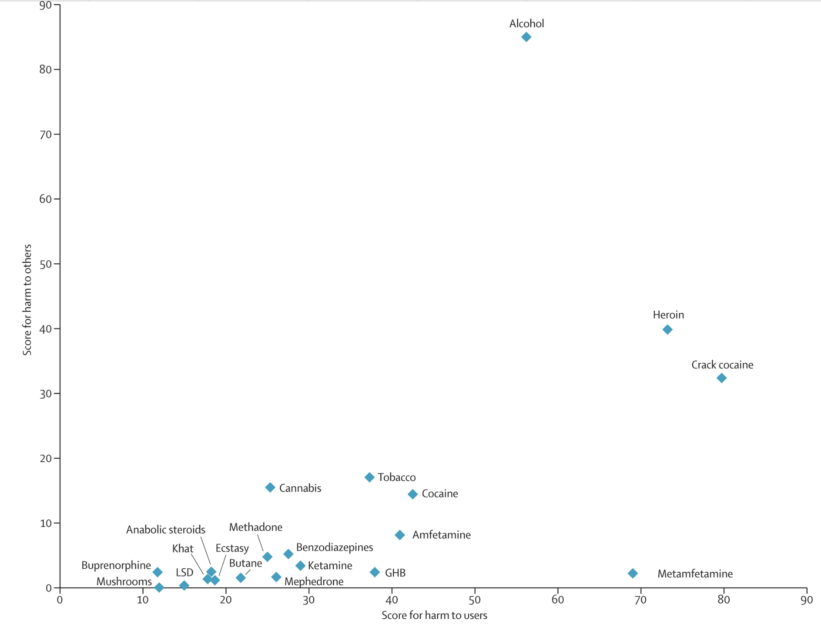
Drugs shown for their harm to self and harm to others
Nutt DJ, King LA, Phillips LD. Drug harms in the UK: a multicriteria decision analysis, The Lancet, Vol 376, Issue 9752, 2010,

Slide 10
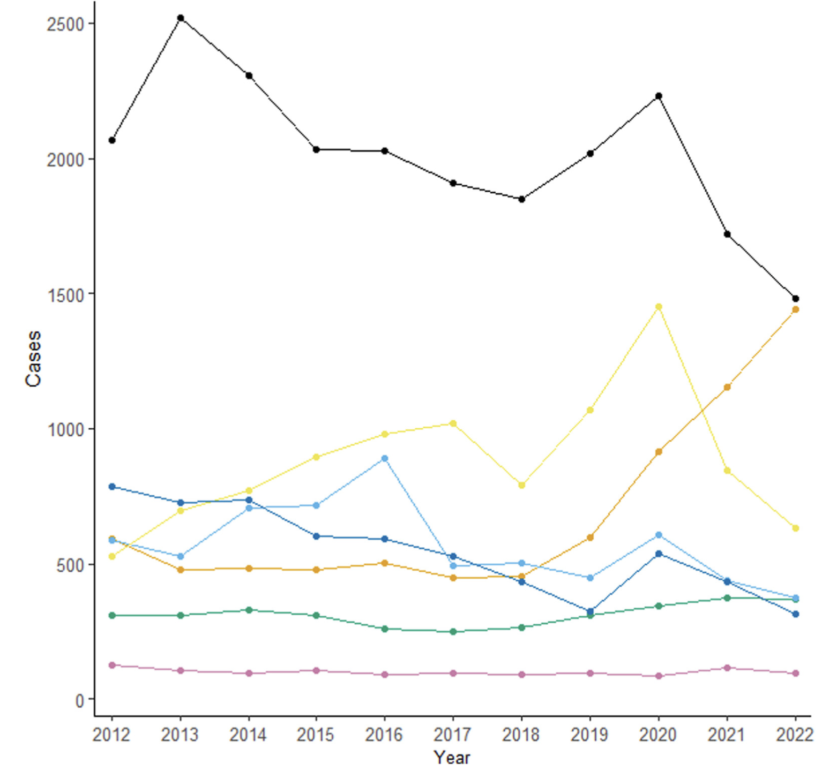
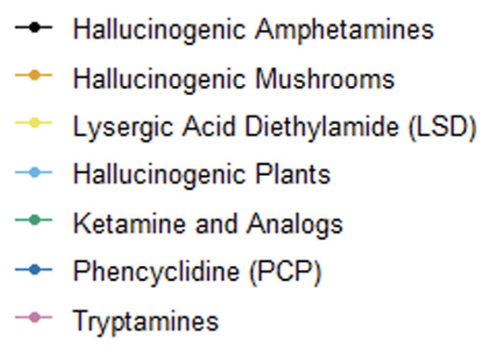
10 year National Poison Data: 54,605 psychedelic exposures.
42% required medical treatment; 0.5% died (265 patients)
Amphetamines (MDMA)
LSD
Psilocybin
Ketamine
Tryptamines (DMT)
Simon MW, Olsen HA, Hoyte CO, Black JC, Reynolds KM, Dart RC, Monte AA. Clinical Effects of Psychedelic Substances Reported to United States Poison Centers: 2012 to 2022. Ann Emerg Med. 2024 Aug
Notes:
Hallucinogenic mushroom exposures increased most over the study period
Overall, 27,444 (50.3%) psychedelic exposures had symptoms that required treatment, severe residual or prolonged symptoms, or death.
Cardiovascular effects were common, especially with MDMA (31.1%).
Patients managed in or referred to a health care facility received medical therapies in 62.4% of cases, including sedation (32.9%) and respiratory interventions (10.3%).

Slide 11
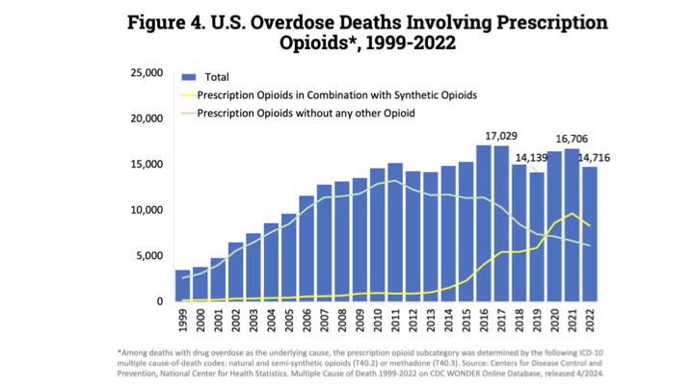

Slide 12
Regulation

Slide 13
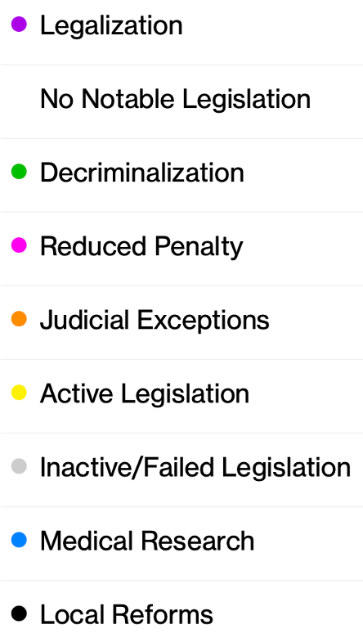
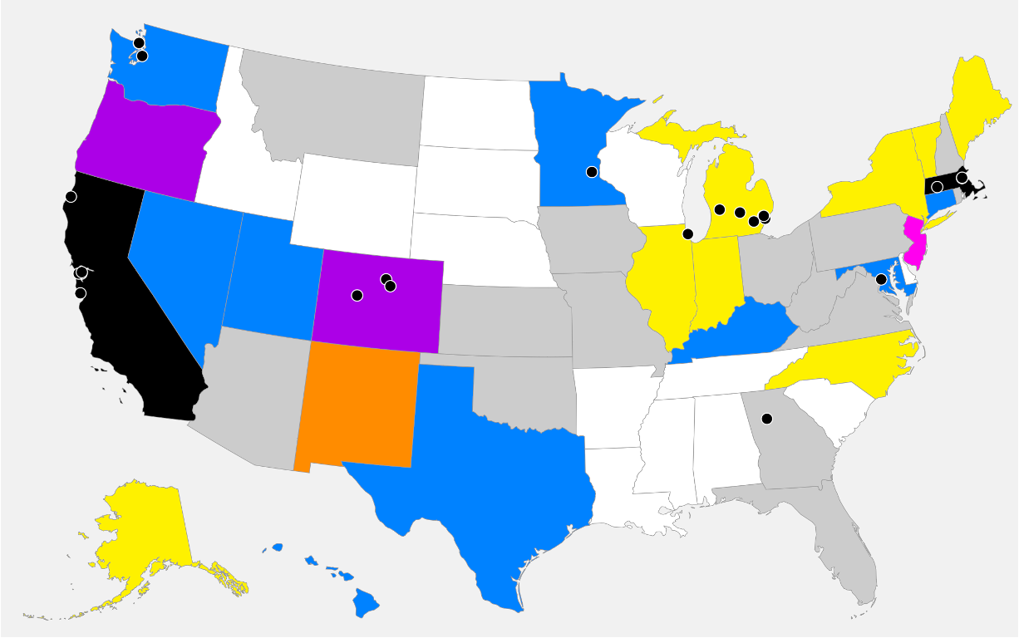
Where are psychedelics (psilocybin) legal in the U.S?
Ketamine is legal in U.S.
OR
CO
As of February 14, 2025
https://psychedelicalpha.com/data/psychedelic-laws

Slide 14
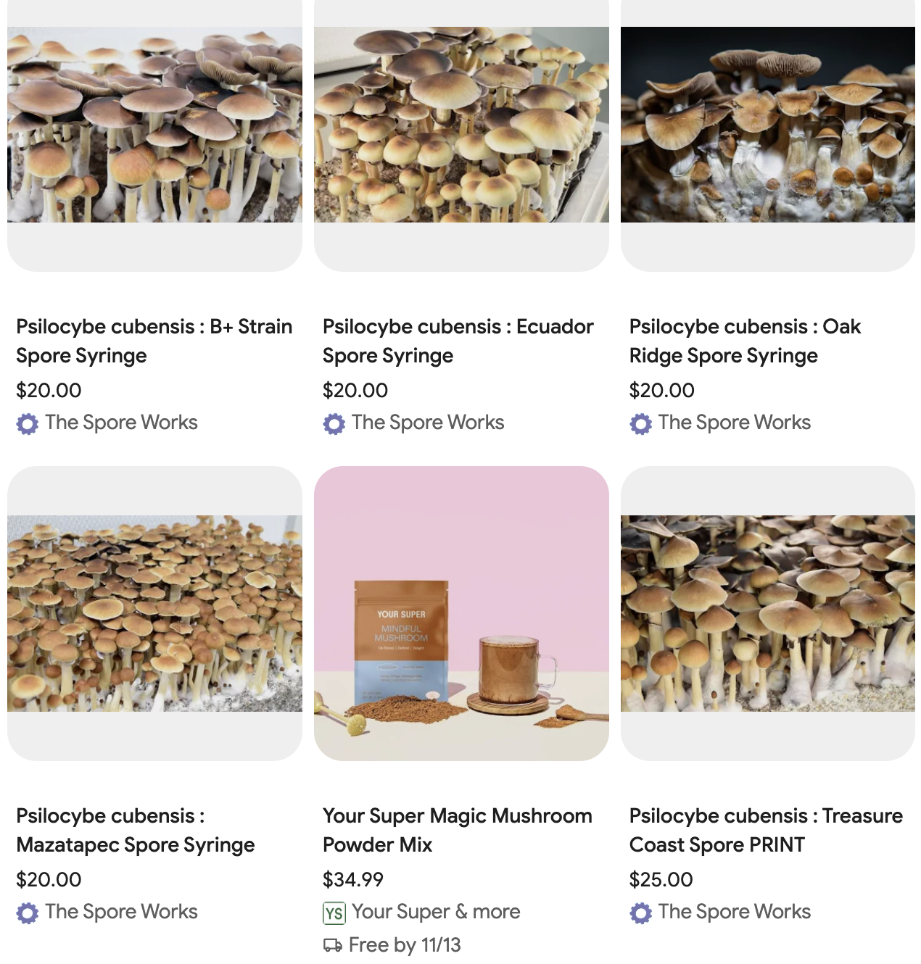
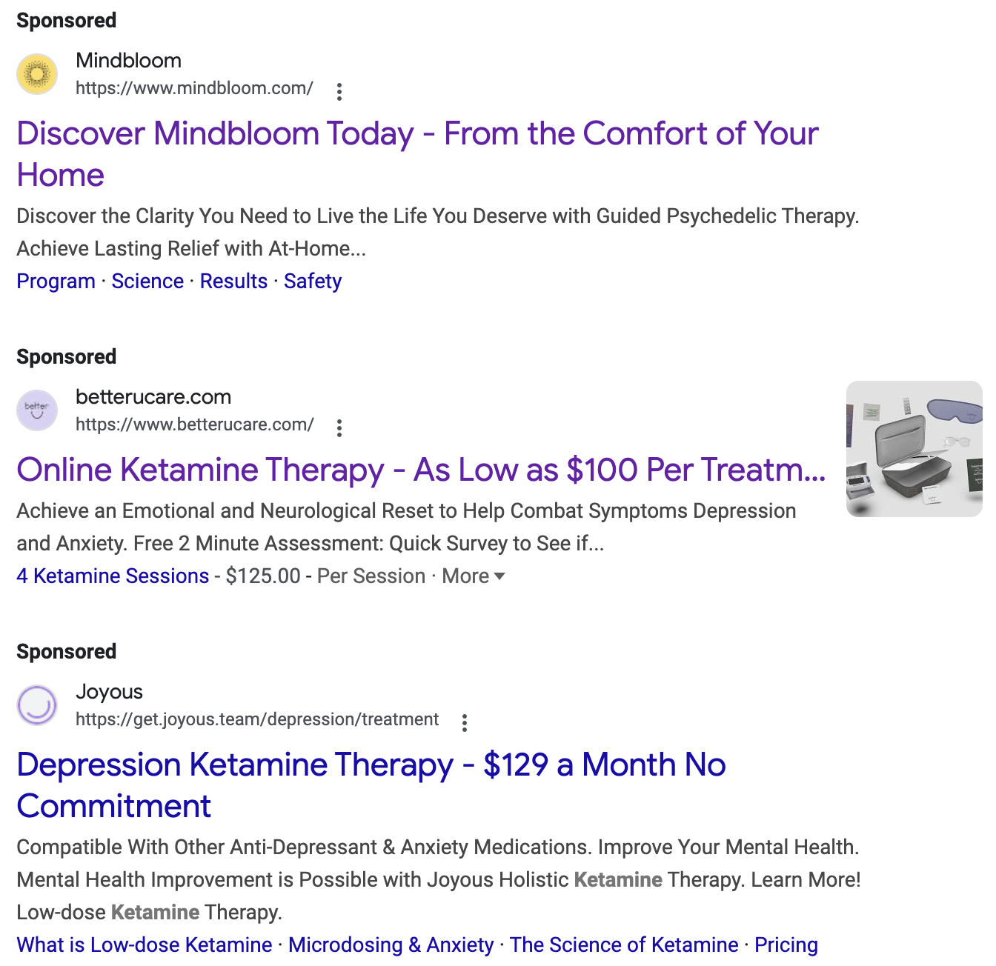
What about mail ordering psychedelic mushrooms & ketamine?
We do not endorse any company. For illustrative purposes only.

Slide 15
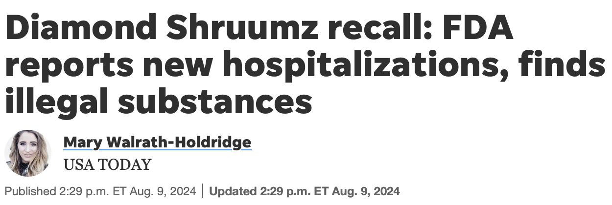
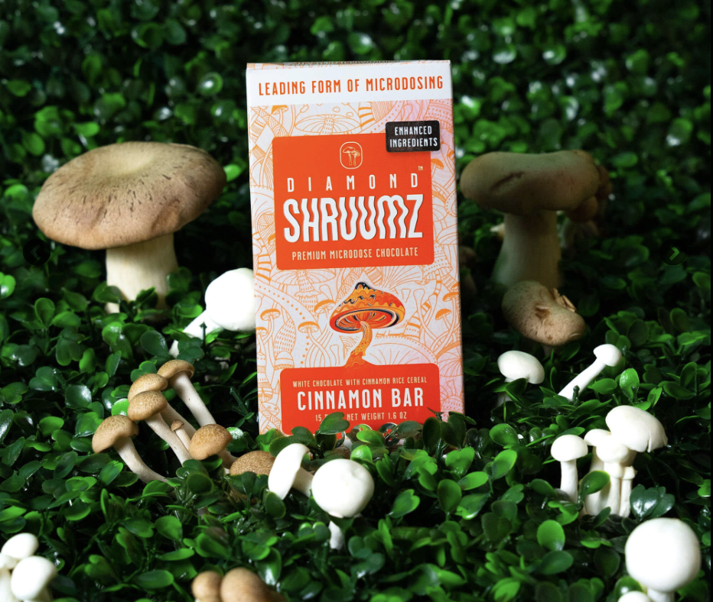
“On Thursday, the FDA released the first round of lab results from testing done on different Diamond Shruumz chocolate bars, revealing that some of the products contained prescription or controlled substances and unlisted compounds.
113 total reported illnesses
42 hospitalizations
2 potentially associated deaths across 28 states.
Psilocin found (expected for Psilocybe spp).
Muscimol found (in Amanita muscaria).
Pregabalin (Lyrica™) found in 3 of the bars.
Kavalactones also found (from kava).

Slide 16
Leslie Me
Ketamine vs. MDMA:
A Case-Based Approach
Erika Steinbrenner, MD
Imagine Healthcare, Epiphany Wellness, Symetria Recovery
Notes:
Both have distinct mechanisms and applications.

Slide 17
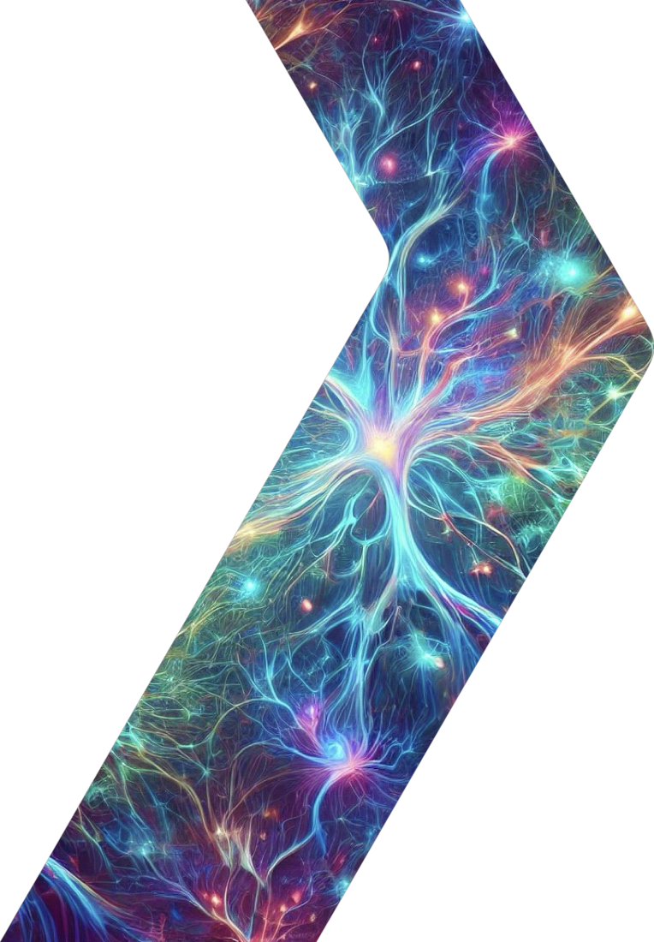
Patient Profile - Peter
55-year-old male veteran with PTSD and TRD
History:
Childhood sexual trauma, military trauma
Multiple failed antidepressant trials
Minimal benefit from therapies (EMDR, CBT)
No psychosis, no substance abuse.
Current Symptoms:
Severe PTSD (CAPS-5 Score: 50)
Severe Depression (PHQ-9: 22)
Passive suicidal ideation.

Slide 18
Patient Profile
Medical History
Denies significant chronic health concerns
Current Medications
Venlafaxine 225 mg
Prazosin 3 mg qHS

Slide 19
Ketamine or MDMA-Assisted Therapy?
Look at the Therapies
Mechanism of Action
Subjective Effects
Indications
Patient Considerations
Contraindications
Medication Interactions
Accessibility

Slide 20
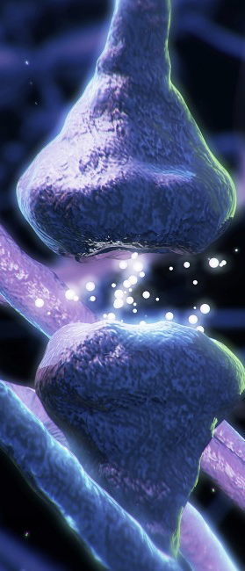
Ketamine
Mechanism of Action:
NMDA receptor antagonist ⇨↑ BDNF and mTOR activity ⇨ synaptic plasticity
Disrupts the Default Mode Network (DMN) ⇨ cognitive flexibility
Subjective Effects:
Dissociative - out of body experience, detached bird’s eye view of one’s life & situation
Therapeutic Result:
Promotes neuroplasticity and ability to alter negative thought patterns
Krystal, J.H., et al. (2023). Ketamine and rapid antidepressant action: new treatments and novel synaptic signaling mechanisms
Kang, M.J., et al. (2022). The mechanisms behind rapid antidepressant effects of ketamine

Slide 21
Ketamine
Administration
Most Common:
IV Infusion - Series of 6 treatments → Maintenance dosing 1x/month.
Esketamine (nasal spray) – 2x/week x 1 month, 1x/week x 1 month, 1x every 1-2 weeks ongoing for maintenance
KAP (Ketamine-Assisted Therapy)
Indications:
Treatment-Resistant Depression
Acute Suicidality
Generalized Anxiety Disorder
PTSD
OCD
Eating Disorders

Slide 22
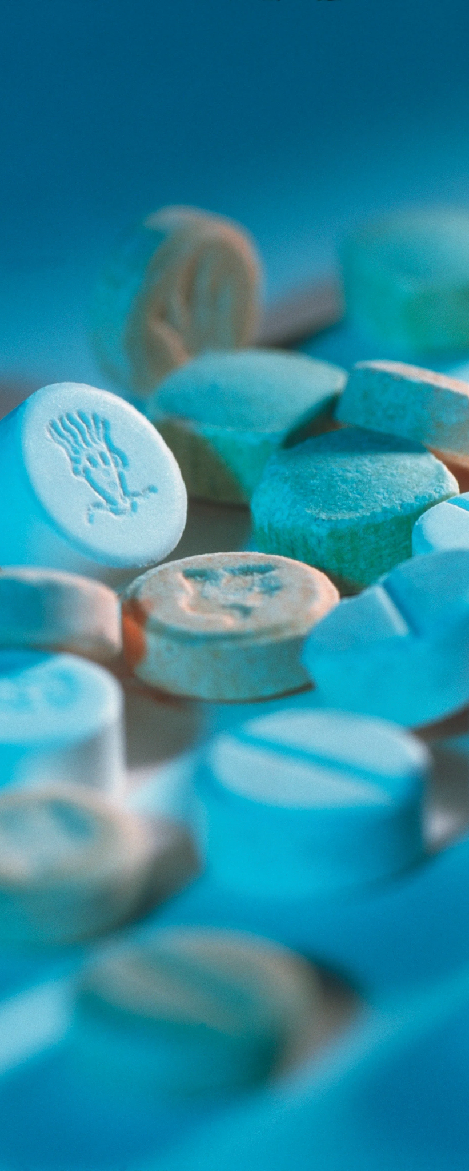
MDMA- Assisted Therapy
Mechanism of Action:
↑ release of neurotransmitters ⇨ serotonin, dopamine, NE
Neurohormonal Effect ⇨ increases oxytocin
↑ BDNF ⇨ neuroplasticity
Subjective Effects:
Empathogen ⇨ engenders feelings of love & warmth
Lowered anxiety/fear response, enhances emotional openness and trust
Rarely causes hallucinations or alterations in perception of self
Therapeutic Result:
Therapy adjunct ⇨ Patients can revisit trauma whilst fear or other emotional defense mechanisms are suspended
Memory reconsolidation ⇨ rewrites maladaptive memory associations and enhance fear extinction
Sottile R.J., et al. (2022). A proposed mechanism for the MDMA-mediated extinction of traumatic memories in PTSD patients treated with MDMA-assisted therapy

Slide 23
MDMA- Assisted Therapy
Administration
One prolonged treatment period (4⁺ months timeline)
Intensive therapy framework
2-3 preparation sessions weekly for 2-3 weeks
Three 8-hour MDMA sessions spaced approx. a month apart
⇨ Therapy session the day after each MDMA session
Integration sessions 2-3 times in the month after last session
Indications:
PTSD

Slide 24
Patient Considerations - Contraindications
KETAMINE
MDMA-ASSISTED THERAPY
PSYCHOLOGICAL
Active mania/psychosis
MEDICAL
Uncontrolled HTN
Aneurysm
Hx aortic dissection, ICH
Hx MI, arrhythmia (*clearance)
Cystitis
Pregnancy/lactation
PSYCHOLOGICAL
Primary psychotic disorder
Bipolar I
Dissociative Identity Disorder
Severe Personality disorders
Eating Disorder w/ Purging
Active substance abuse disorder
Serious Suicide Risk
MEDICAL
Uncontrolled HTN
Baseline QTc prolongation / cardiac risk factors
Symptomatic liver disease
Pregnancy/lactation
Mitchell, J.M., et al (2021). MDMA-assisted therapy for severe PTSD: a randomized, double-blind, placebo-controlled phase 3 study

Slide 25
Patient Considerations - Medication Interactions
KETAMINE
MDMA-ASSISTED THERAPY
Benzodiazepines → Muted effects; hold day of tx
Lamotrigine → Muted effects
Stimulants → hold day of tx
SSRIs/SNRIs/TCAs→ Muted effects and ↓ efficacy
Mirtazapine & Trazodone → Muted effects
MAOIs → Contraindicated - serotonin toxicity
Benzodiazepines → Muted effects, possible ↓ efficacy
Stimulants → Added stimulant toxicity
Lithium → Contraindicated - increased risk seizures
CYP2D6 inhibitors (Bupropion) → Increases blood concentrations of MDMA
CYP3A4/5 inhibitors (Ritonavir/cobicistat) → Potentially fatal serotonin toxicity
Mitchell, J.M., et al (2021). MDMA-assisted therapy for severe PTSD: a randomized, double-blind, placebo-controlled phase 3 study

Slide 26
Patient Considerations - Accessibility
KETAMINE
MDMA-ASSISTED THERAPY
Legal in all 50 states
Only legal if part of clinical trial
Recruiting (as of 2/16/25):
MDMA Plus Exposure Therapy for PTSD
(Emory University)
MDMA for AUD/PTSD Comorbidity
(Brown University)
MDMA-Assisted Massed Prolonged Exposure for PTSD (MDMA-PE) (VA - San Diego)
MDMA-Assisted Brief Cognitive Behavioral Conjoint Therapy for PTSD (MDMA-bCBCT) (VA - San Diego)
Not Yet Recruiting (as of 2/16/25):
MDMA-Assisted Therapy vs CPT for Veterans with Severe PTSD (VA - Palo Alto)
MDMA-Assisted Therapy for Veterans with Moderate to Severe PTSD (VA - Los Angeles)
Source: Clinicaltrials.gov
Notes:
There’s always the underground…

Slide 27
Insert slide of an ‘underground’ graphic….
Find a cave image?

Slide 28
Back to Our 55y Veteran with PTSD…
Ketamine = Rapid relief, help with depression, ongoing treatment.
MDMA = Deep trauma processing, lasting change.
In an ideal world …..could benefit from both
Ketamine first to help taper off antidepressant & improve depression & SI
MDMA to focus on PTSD

Slide 29
Leslie Me
Psilocybin
Mikhail Kogan, MD
George Washington University
GW Center for Integrative Medicine

Slide 30
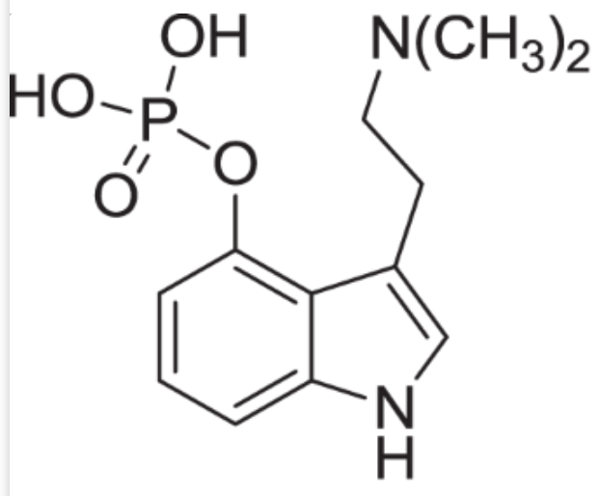
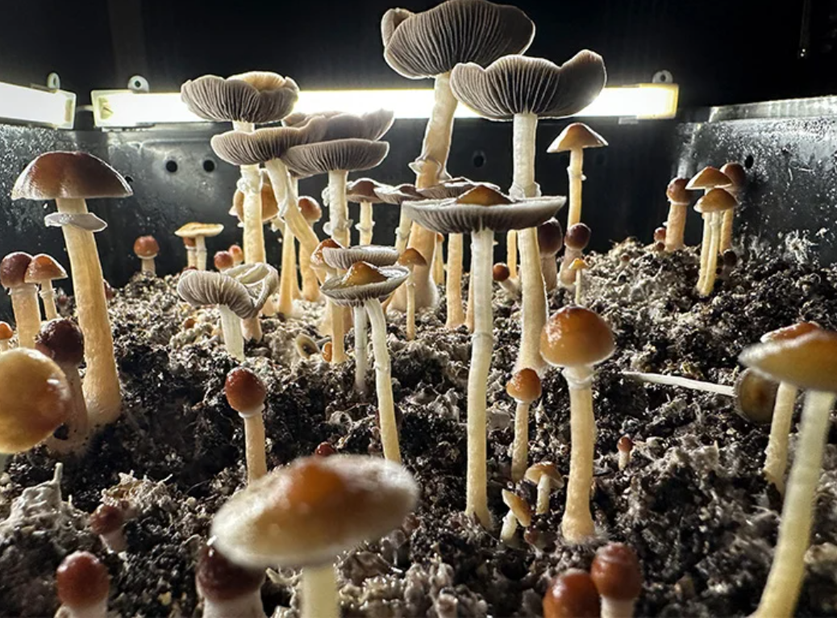
Psilocybin (Mushrooms)
MOA: Serotonin receptor agonist, particularly targeting 5-HT2A receptors
Route: Typically oral, consumed in dried mushroom form or as an extract (note most trials to date use injection of pure extract)
Effects: Euphoria, altered perception of time and space, visual and auditory hallucinations, introspection, spiritual experiences
Side Effects: Nausea, anxiety, paranoia, increased heart rate, pupil dilation, derealization or depersonalization
Contraindications: History of psychosis or psychotic disorders, severe cardiovascular disease, pregnancy
Combining with SSRIs/SNRIs: May diminish effects due to serotonin receptor competition; potential for increased risk of serotonin syndrome, use caution

Slide 31
Let’s look at 2 cases
Who? | Kate 62 year old woman with metastatic ovarian cancer. on palliative care | Brian 36 year old man with long standing mild depression contributing to problems at home with wife and children. Never felt any help from Antidepressants
Why? | Struggling with accepting death and looking for more peace in last months | Hoping to improve depression and better family relationships
Why Psilocybin? | Perception of “softer more mystical experience” | Friend did it for his depression and had amazing improvement
Anticipation/Expectation | Mystical experience/Closer connection to God, reinstate lost faith | Break from reality into nonlinear healing

Slide 32
2 Cases continue
 | Kate | Brian
Settings | Weekend long retreat in cabin the woods 2 participants - Kate and her husband | Weekend long retreat in cabin the woods 5 participants all young people in 20s-40s
Preparation | Several meetings with psychedelic coach, meeting with psychiatrist and palliative care social worker | One meeting with psychiatrist and conversation with friend and one meeting with psychedelic coach
Dose/Type | High dose (ground mushroom) mixed with yogurt (patient’s request) | High dose mushroom chewed directly (patient’s request)
Psychedelic effects | Minimal psychedelic effect, more like relaxation and periods of peace without any major “God like moments” | Profoundly deep state of awareness of unity and peace for 3-4 hours, long profound conversation with one of the coaches at the end of the trip

Slide 33
2 Cases continue
 | Kate | Brian
Side effects | Intermittent nausea and vomiting that led to need for IV hydration. | None
Day after/Early Integration | Some decrease in anxiety, difficult integration due to severe side effects. | Barely can speak, feels that entire world shifted, lots of tears of joy, integration mostly listening and meditating with others.
Long term feedback after 12 weeks | Felt that experience was not worth money and effort despite still grateful for being able to do it. | “My life is so different, as if I had 10 years of therapy squeezed into 6 hours.”

Slide 34
So what happened with our patients?
 | Kate | Brian
Anticipation vs Reality | Anticipated a lot but being frail and struggling with pre-existing cancer related symptoms led to severe purging that patient was not able to get through to the actual true psychedelic experience despite coaching. | Was guarded but effect was beyond anything anticipated.
Right Choice? Wrong Choice? How could this be improved? | Pretreating with strong anti-emetic if patient insists on trying but really - may be not the best substance and trial of Ketamine would have been better. | Right Choice
Main lessons | Frailty and advanced illness makes psilocybin sessions unpredictable and physiological side effects more common. | High dose combined with decent preparation for depression can be life transforming in 1 session.

Slide 35
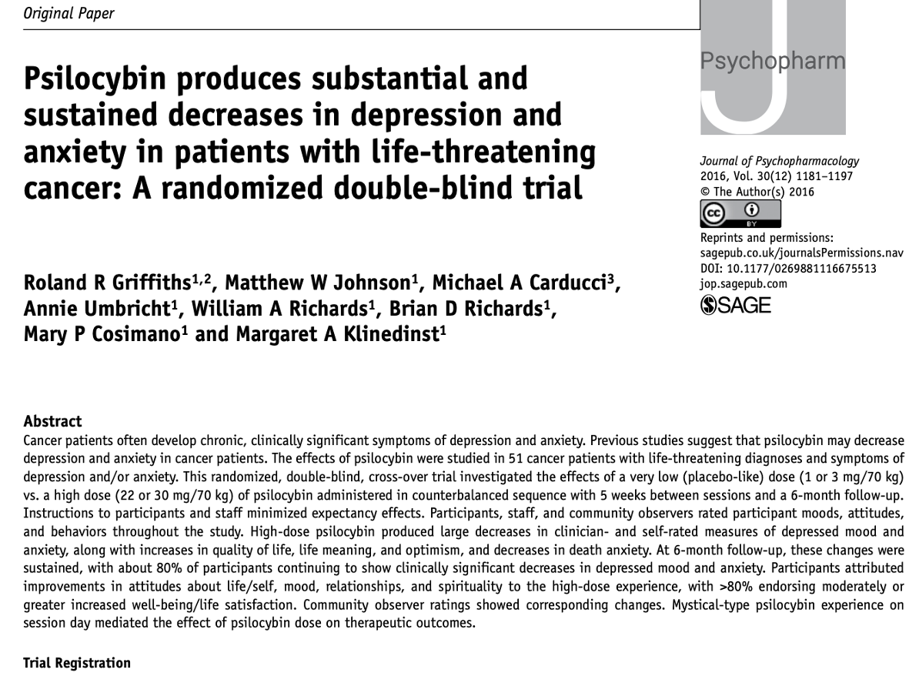
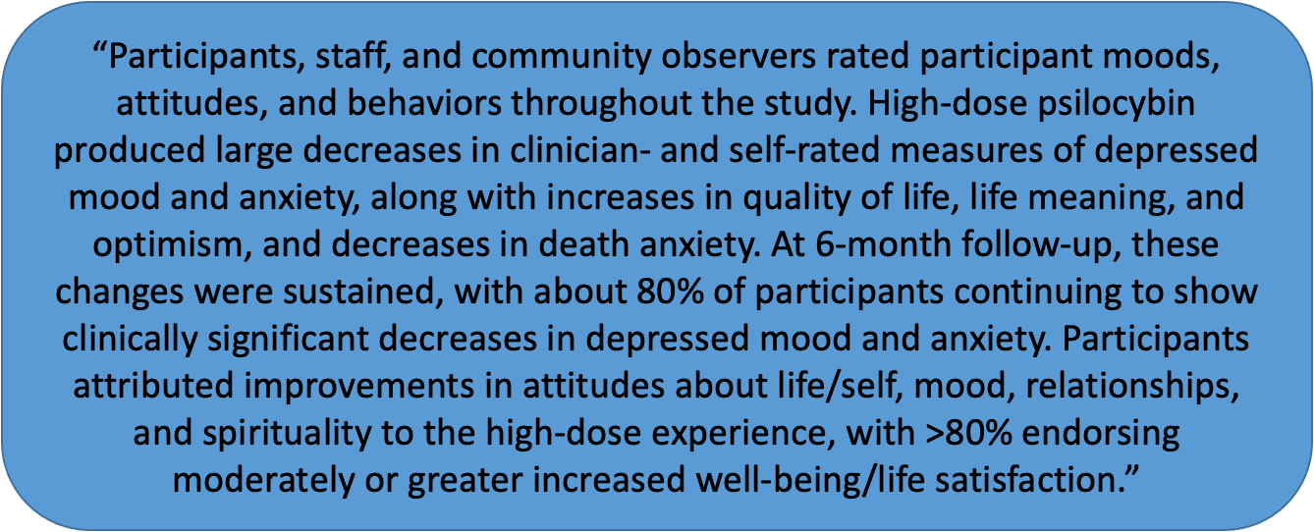
Real Life vs Studies?

Slide 36
Determining candidacy for psilocybin?
Contraindications and safety precautions…. Misha to add

Slide 37
Ayahuasca (Misha)
Case 4
A 67 year old man going through divorce is feeling anxiety and depression. He is curious about going away on an Ayahuasca retreat in South America and asks what you think of the idea.

Slide 38
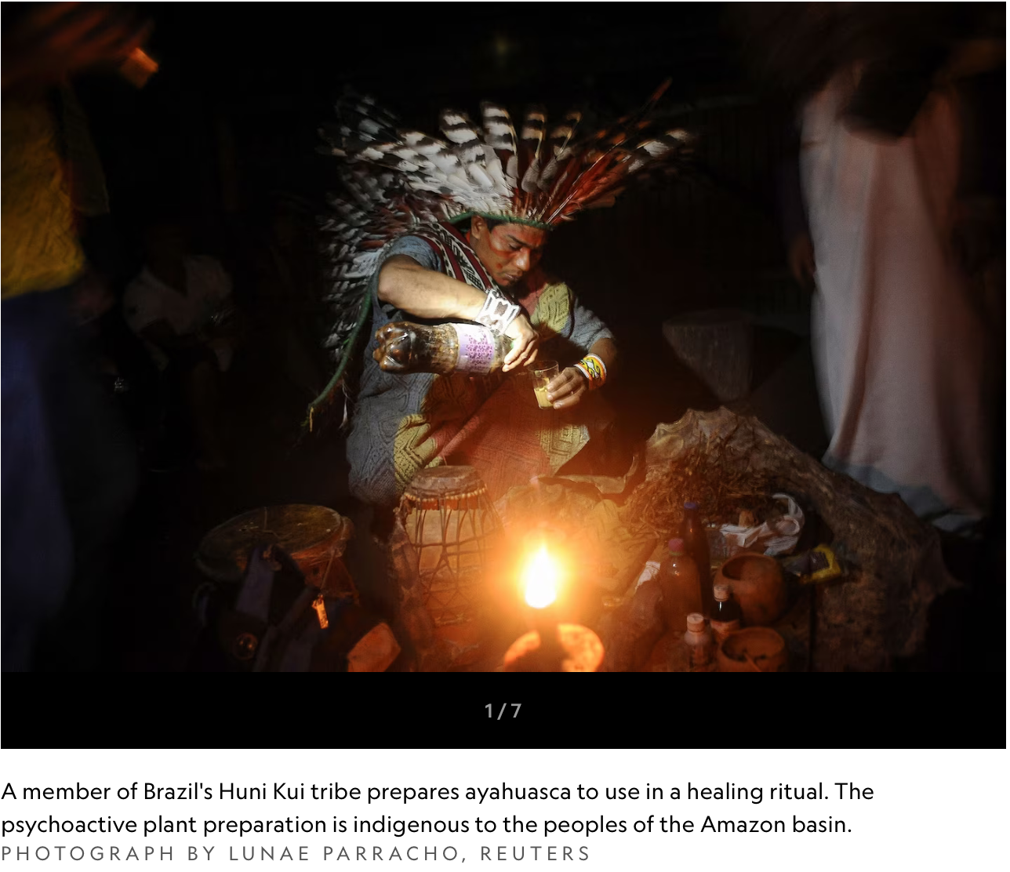
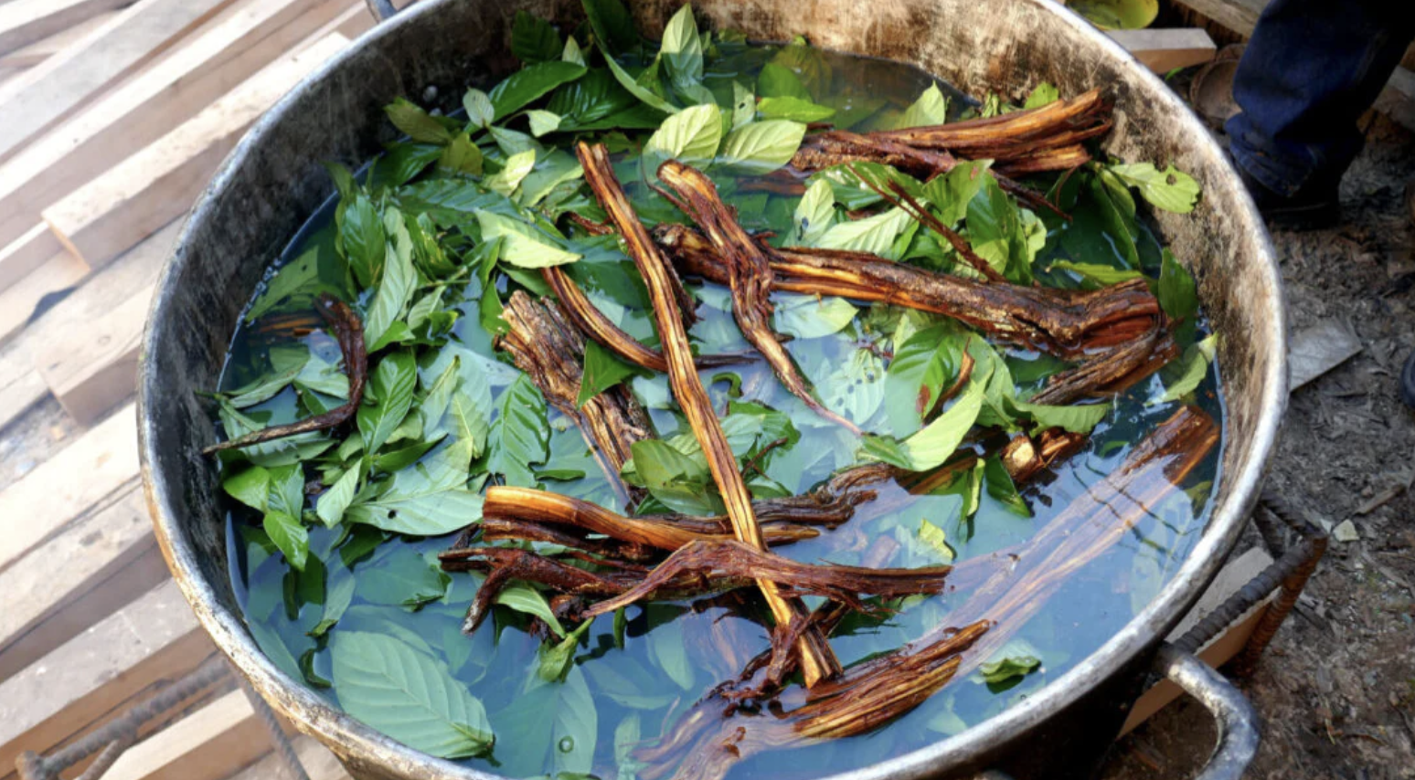
Ayahuasca
Ayahuasca is a combination of two plants from the Amazon basin- a leaf containing DMT and a vine containing an MAO inhibitor into a brew.
Mechanism of action: 5-HT2A receptor activation.
Duration: 4-6+ hours
Subjective effects: Visual patterns, contact with ‘beings’, heightened perception; provide access to normally invisible and immaterial worlds
Side effects: “The purge”: vomiting, diarrhea; increase BP, HR
Research: depression, anxiety, substance use disorder, grief
Considerations: Ayahuasca is used ceremonially often in remote spaces; Has most potential drug interactions due to MAO activity. Difficult to know dosing (variable concentrations, proportions)
Notes:
Ayahuasca is also known as caapi, daime, hoasca, and vegetal. Ayahuasca is a Quechua word meaning “vine of the soul” or “vine of the dead”, pointing to its ability to provide access to normally invisible and immaterial worlds. DMT occurs naturally in animals & humans. MAOI component prevents DMT deactivation in gut.

Slide 39
Leslie Me
The psychedelic experience - Practical guidance for conscious journeying and harm reduction
Thais Salles Araujo, MD: Institute for Integrative Healology, UCLA East-West Medicine, Modern Medicine, Mystic Health, Roze Room Hospice & Palliative Care
Justin Laube, MD: Institute for Integrative Healology, UCLA East-West Medicine, Modern Medicine, Everyday Health

Slide 40
What is our role, as integrative practitioners, in guiding our patients?
→Most patients under report CAM and psychedelic use.
→If a patient is bringing it up, it’s a sign of their trust in you to help them navigate a confusing landscape.
→As an integrative medicine practitioner, what is a way to engage with your patient using evidence and safety guided directioning?
→Just like any other supplement, or new healing approach:
Indication
Benefits/risks/options
Integrative approach
Cost
Quality/certification of delivery & practitioner
Quality of evidence
Psychedelic medicine. Patient experiences… 4,Sept, 2024….

Slide 41
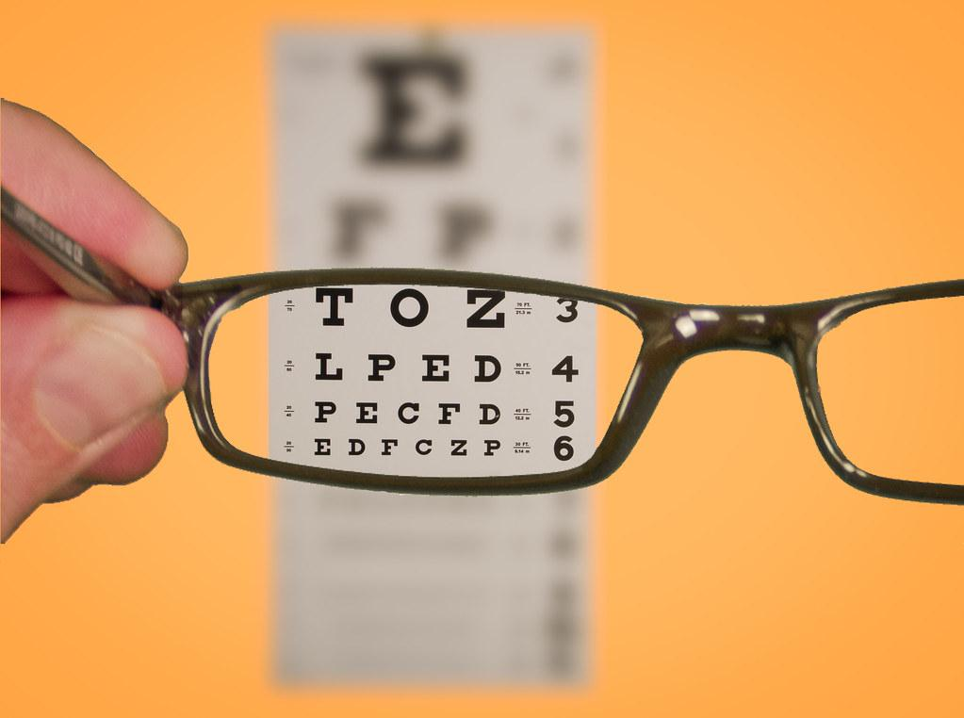
We are used to medications and prescriptions that don’t seem to require special preparation, setting or integration. Like a muscle relaxant for a week post back spasm.
To engage with psychedelics does require putting on new glasses, recognizing it’s a whole experience, including the intentionality that matters, with the medicine as an augmentor. And includes therapy wrapped in.
Psychedelics and the essential importance of context. J.Psychopharmacology.2018….

Slide 42
Harm reduction models in IM and Psychedelics - Respect for the patients longing to heal
Harm reduction incorporates a spectrum of strategies that includes safer use, managed use, abstinence, meeting people who use drugs[ IM therapies/psychedelics] “where they're at,” and addressing conditions of use along with the use itself.
https://harmreduction.org/about-us/principles-of-harm-reduction
Chang JE, Lindenfeld Z, Hagan H. Integrating Harm Reduction into Medical Care: Lessons from Three Models. J Am Board Fam Med. 2023
https://pmc.ncbi.nlm.nih.gov/articles/PMC10636714/

Slide 43
Patients history
Peter
55 yo M veteran with PTSD and treatment - resistant depression.
Kate
A 62 yo F with metastatic ovarian cancer struggles with accepting death.
Brian
A 36 yo M decades + history of depression
Henry
67 yo M divorce is feeling anxiety and depression. Ayahuasca retreat in South America

Slide 44
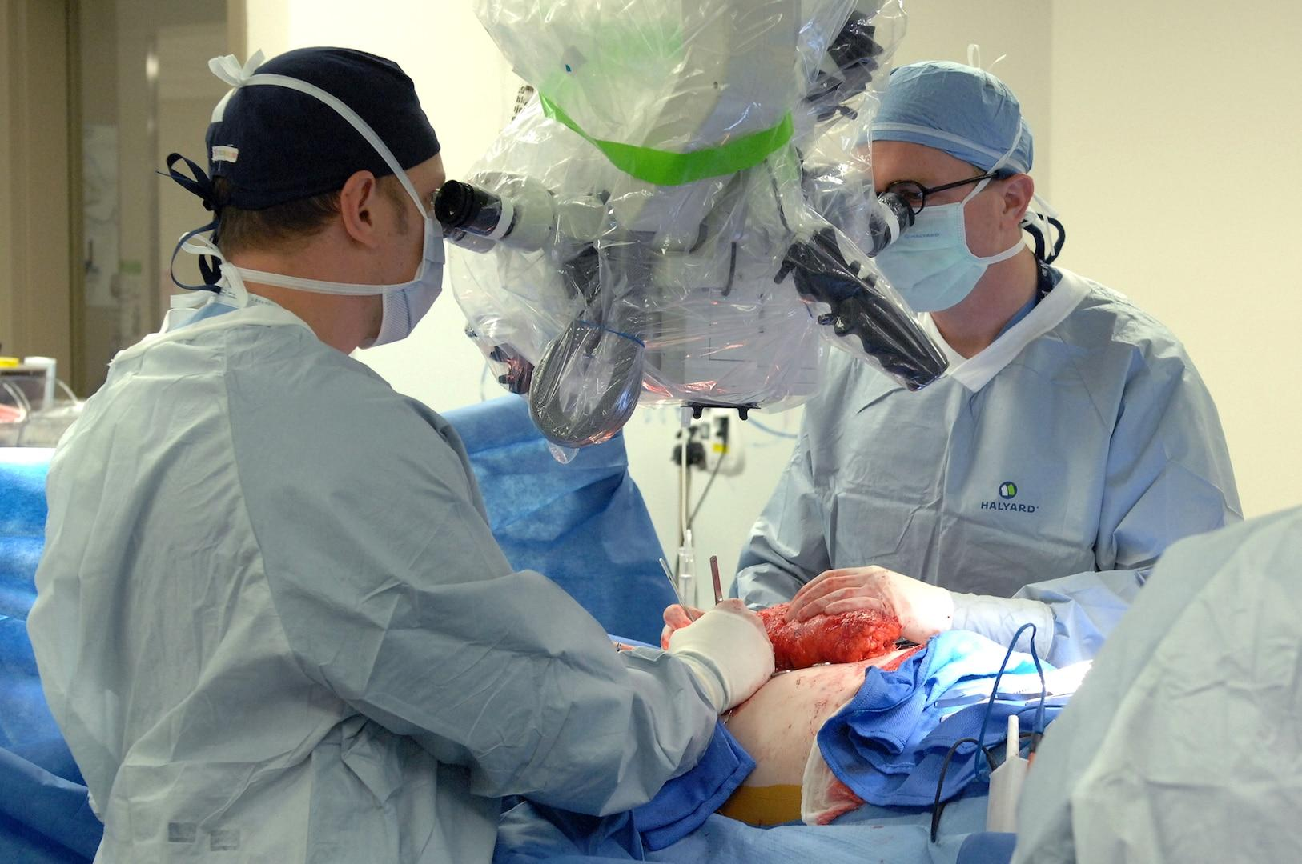
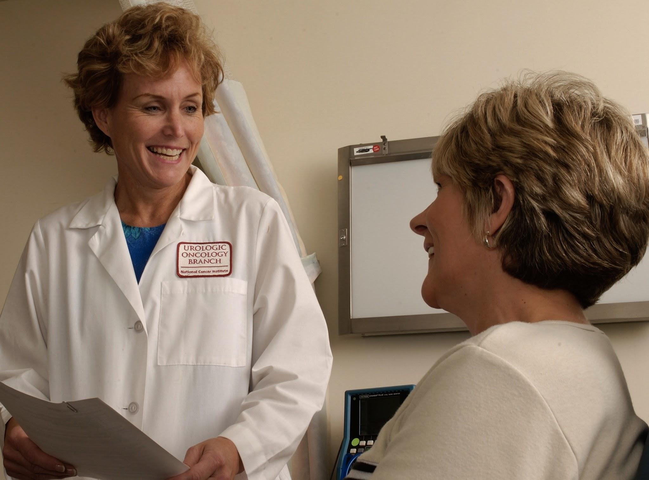
Psychedelics - Pre-op & Harm Reduction
Appropriateness of psychedelic experiences, and at this time of their life?
Physical and psychological health and fitness
Risk and Benefits
Have they failed other conventional approaches/measures?
Like elective surgery is not typically 1st line
Psychedelic facilitators (surgeon) qualifications
Ethical standards around funds, sexual abuse risk, manipulation
Outpatient procedure, hospital based surgery? Post op/recovery need of PCU, ICU?
Driving and transport considerations
What to expect for different experiences
Time off of work, family preparations
Case 1
2
3
4
(Column of case e.g. considerations and how navigate these q’s)

Slide 45
MDMA, Psilocybin, Ketamine all “consciousness medicines”
MDMA
PSILOCYBIN
KETAMINE
Empathogen
Connection/Love - self & others
Lowers fear responses
Optimal Therapy Adjunct
Entheogen
Organic, softer, introspective
Connection with nature/spiritual
Mystical experience
Somatic: activating
Dissociative
Disconnection from body
Bird’s Eye Perspective
Rapid effects on SI
Somatic: sedative, relaxation
Considerations:
Severity of patient’s problem
Intention
Preferences / Timeframe / Social factors
Finances
Current medications
Access to facilitated experiences
“And/Both” not “Either/Or”
All: Set/Setting/Support & Integration Important
AYAHUASCA

Slide 46
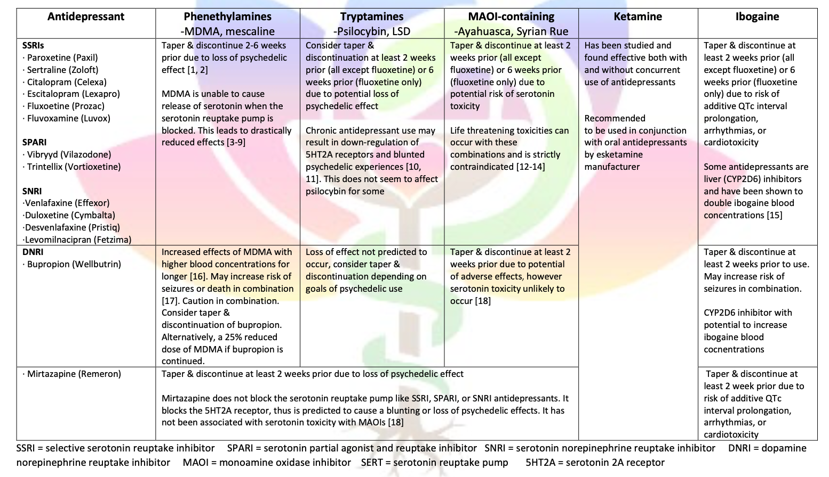
spiritpharmacist.com 2.23.2025…

Slide 47
Setting and risk considerations example
IV ketamine
w/ monitored RN
Ayahuasca in remote jungle with indigenous guide
Are the risks needed for their intention, if so, what level of risk?
Recognize: Psychedelic-like non-ordinary states without psychedelic medicines exist and can be just as healing and/or complementary to support integration - E.g. prolonged meditation retreats, spiritual retreats, pilgrimages, holotropic breathwork, fasting nature quests, shamanic journeying, music/drumming deep experiences.

Slide 48
Psychedelics - Pre-op Harm Reduction
Drug-drug interactions (introduced by erika/misha)
(Show examples)
Symptom concerns (introduced by erika/misha)
E.g. ketamine and nausea
Fasting/diet considerations (e.g. DM2)
Who’s leading?
1:1 or group
Type of group experience
Couples based?
Clinic or outside clinic realms
US or abroad
Dosing, (multi med) mega doses? # of experiences and timing?
Source of the medicine: drug testing kits
What to bring, and electronics plan
Case 1
2
3
4
(Column of case e.g. considerations and how navigate these q’s)

Slide 49
Considerations for Psychedelic Surgery Day! (Ask your patients about their experiences)
Who is guiding
How are they guiding
Sitting presence
Active therapy
Movement allowed?
Traditional approaches used by indigenous or local practitioners
What is normal and what is abnormal
Music as a therapy and silence too
Setting and environment that is supportive
Emergency plan and who is leading
Post experience recovery plan, hydration, food, early integration

Slide 50
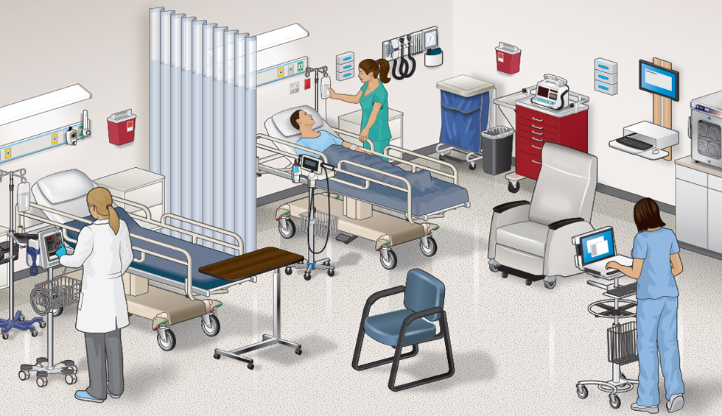
Psychedelics - Post-Op PACU - What might be supportive when you see your patient post journey
Recovery or potentially open wounds
Rest, recovery needs
Neuroplasticity window wide open
Attention to inputs
Really adopt integration as key next steps
How do you process and make sense of big experiences?
Art, journaling, talking, quiet time, nature time, good friend listening time…
Driver home and return to safe lodging
Time off, Self care
Restarting diet, liquids. Restarting sexuality or sensorially intense experiences.
Avoid quick decisions
Meeting guides / therapists / etc

Slide 51
Psychedelics - Surgical Recovery
What’s next? After you had a significant experience that may be healing or been challenging?
Still have the laundry, and your mind doing it’s thing as “you”. Wah wah.
Continued working the dough, get help, therapists, guides, spiritual elders, who know about trauma and healing states.
Reconnect with the intention, avoid attachment to the actual experience or that more psychedelics are the only way forward.
Neuroplasticity study…

Slide 52
Call to action: To strike a balance between seemingly opposing forces.
Engineer safe supply of psychedelic substances when legislation allows.
Keep the cost of the medicine session within reach. Insurance may cover integration talk therapy, depending on the therapist.
Promote public and professional education to maximize benefit and minimize potential harms.

Slide 53
Speakers
Leslie Mendoza Temple, MD: Endeavor Health, University of Chicago Pritzker School of Medicine
Erika Steinbrenner, MD: Imagine Healthcare, Epiphany Wellness, Symetria Recovery
Mikhail Kogan, MD: George Washington University, GW Center for Integrative Medicine
Thais Salles Araujo, MD: Institute for Integrative Healology, UCLA East-West Medicine, Modern Medicine, Mystic Health, Roze Room Hospice & Palliative Care
Justin Laube, MD: Institute for Integrative Healology, UCLA East-West Medicine, Modern Medicine, Everyday Health
Notes:
Insert everyone’s logos at bottom of this page

Slide 54
Leslie Me
Discussion
Notes:
Leslie sorts written questions and distributes to the panelists.

